Slide 1
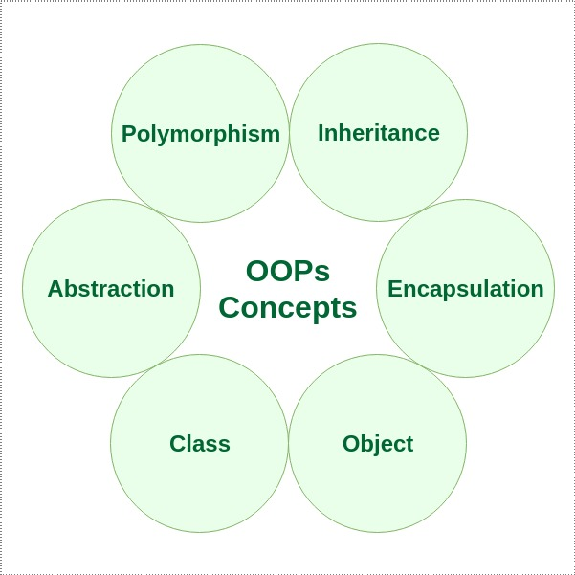

Slide 2
Class
A class is a user defined blueprint or prototype from which objects are created. It represents the set of properties or methods that are common to all objects of one type. In general, class declarations can include these components, in order:
Modifiers: A class can be public or has default access (Refer this for details).
Class name: The name should begin with a initial letter (capitalized by convention).
Superclass(if any): The name of the class’s parent (superclass), if any, preceded by the keyword extends. A class can only extend (subclass) one parent.
Interfaces(if any): A comma-separated list of interfaces implemented by the class, if any, preceded by the keyword implements. A class can implement more than one interface.
Body: The class body surrounded by braces, { }.

Slide 3
Object
Object: It is a basic unit of Object Oriented Programming and represents the real life entities. A typical Java program creates many objects, which as you know, interact by invoking methods. An object consists of:
State : It is represented by attributes of an object. It also reflects the properties of an object.
Behavior : It is represented by methods of an object. It also reflects the response of an object with other objects.
Identity : It gives a unique name to an object and enables one object to interact with other objects

Slide 4
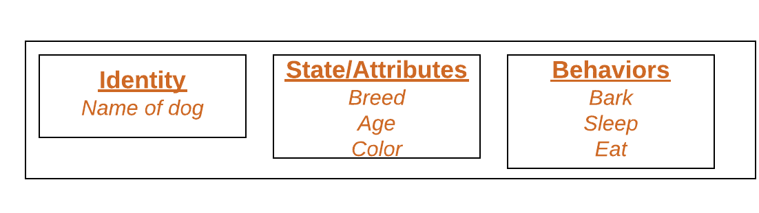

Slide 5
Method
Method: A method is a collection of statements that perform some specific task and return result to the caller. A method can perform some specific task without returning anything. Methods allow us to reuse the code without retyping the code. In Java, every method must be part of some class which is different from languages like C, C++ and Python.
Methods are time savers and help us to reuse the code without retyping the code
Method Declaration
In general, method declarations has six components:
Access Modifier: Defines access type of the method i.e. from where it can be accessed in your application. In Java, there 4 type of the access specifiers.
public: accessible in all class in your application.
protected: accessible within the package in which it is defined and in its subclass(es)(including subclasses declared outside the package)
private: accessible only within the class in which it is defined.
default (declared/defined without using any modifier): accessible within same class and package within which its class is defined.
The return type: The data type of the value returned by the method or void if does not return a value.
Method Name: the rules for field names apply to method names as well, but the convention is a little different.
Parameter list: Comma separated list of the input parameters are defined, preceded with their data type, within the enclosed parenthesis. If there are no parameters, you must use empty parentheses ().
Exception list: The exceptions you expect by the method can throw, you can specify these exception(s).
Method body: it is enclosed between braces. The code you need to be executed to perform your intended operations.

Slide 6
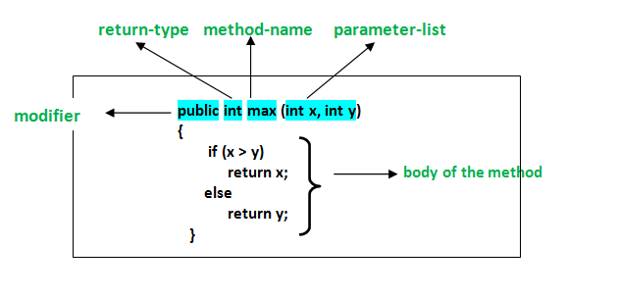

Slide 7
Inheritance
is a mechanism in which one object acquires all the properties and behaviors of a parent object. It is an important part of OOPs (Object Oriented programming system).
The idea behind inheritance in Java is that you can create new classes that are built upon existing classes. When you inherit from an existing class, you can reuse methods and fields of the parent class. Moreover, you can add new methods and fields in your current class also.
Inheritance represents the IS-A relationship which is also known as a parent-child relationship.

Slide 8
Class: A class is a group of objects which have common properties. It is a template or blueprint from which objects are created.
Sub Class/Child Class: Subclass is a class which inherits the other class. It is also called a derived class, extended class, or child class.
Super Class/Parent Class: Superclass is the class from where a subclass inherits the features. It is also called a base class or a parent class.
Reusability: As the name specifies, reusability is a mechanism which facilitates you to reuse the fields and methods of the existing class when you create a new class. You can use the same fields and methods already defined in the previous class.

Slide 9
class Subclass-name extends Superclass-name
{
//methods and fields
}
The extends keyword indicates that you are making a new class that derives from an existing class. The meaning of "extends" is to increase the functionality.
In the terminology of Java, a class which is inherited is called a parent or superclass, and the new class is called child or subclass

Slide 10
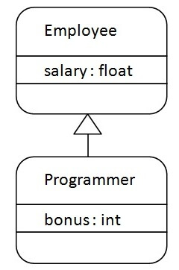
As displayed in the above figure, Programmer is the subclass and Employee is the superclass. The relationship between the two classes is Programmer IS-A Employee. It means that Programmer is a type of Employee.

Slide 11
class Employee{
float salary=40000;
}
class Programmer extends Employee{
int bonus=10000;
public static void main(String args[]){
Programmer p=new Programmer();
System.out.println("Programmer salary is:"+p.salary);
System.out.println("Bonus of Programmer is:"+p.bonus);
}
}
In the above example, Programmer object can access the field of own class as well as of Employee class i.e. code reusability.

Slide 12
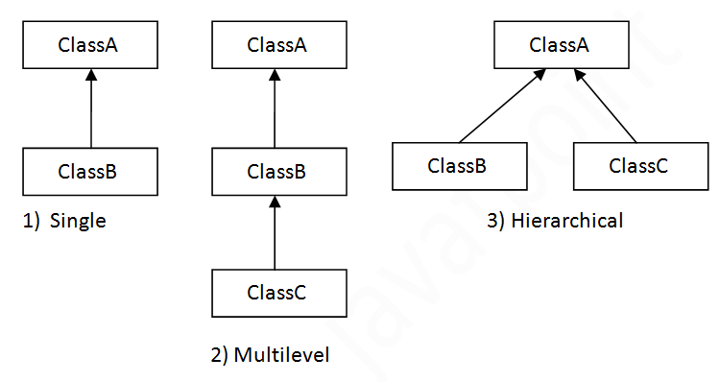
Types of inheritance in java
On the basis of class, there can be three types of inheritance in java: single, multilevel and hierarchical.
In java programming, multiple and hybrid inheritance is supported through interface only. We will learn about interfaces later.

Slide 13
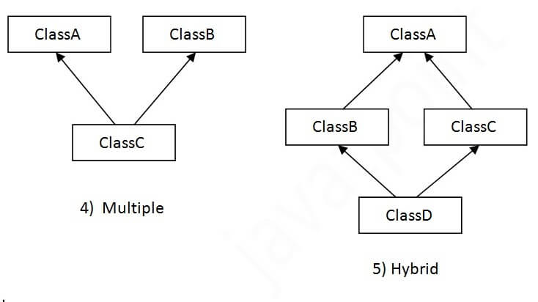
When one class inherits multiple classes, it is known as multiple inheritance. For Example:

Slide 14
Single Inheritance Example
When a class inherits another class, it is known as a single inheritance. In the example given below, Dog class inherits the Animal class, so there is the single inheritance.
File: TestInheritance.java
class Animal{
void eat(){System.out.println("eating...");}
}
class Dog extends Animal{
void bark(){System.out.println("barking...");}
}
class TestInheritance{
public static void main(String args[]){
Dog d=new Dog();
d.bark();
d.eat();
}}

Slide 15
Multilevel Inheritance Example
When there is a chain of inheritance, it is known as multilevel inheritance. As you can see in the example given below, BabyDog class inherits the Dog class which again inherits the Animal class, so there is a multilevel inheritance.
File: TestInheritance2.java
class Animal{
void eat(){System.out.println("eating...");}
}
class Dog extends Animal{
void bark(){System.out.println("barking...");}
}
class BabyDog extends Dog{
void weep(){System.out.println("weeping...");}
}
class TestInheritance2{
public static void main(String args[]){
BabyDog d=new BabyDog();
d.weep();
d.bark();
d.eat();
}}

Slide 16
Hierarchical Inheritance Example
When two or more classes inherits a single class, it is known as hierarchical inheritance. In the example given below, Dog and Cat classes inherits the Animal class, so there is hierarchical inheritance.
File: TestInheritance3.java

Slide 17
class Animal{
void eat(){System.out.println("eating...");}
}
class Dog extends Animal{
void bark(){System.out.println("barking...");}
}
class Cat extends Animal{
void meow(){System.out.println("meowing...");}
}
class TestInheritance3{
public static void main(String args[]){
Cat c=new Cat();
c.meow();
c.eat();
//c.bark();//C.T.Error
}}

Slide 18
Why multiple inheritance is not supported in java?
To reduce the complexity and simplify the language, multiple inheritance is not supported in java.
Consider a scenario where A, B, and C are three classes. The C class inherits A and B classes. If A and B classes have the same method and you call it from child class object, there will be ambiguity to call the method of A or B class.
Since compile-time errors are better than runtime errors, Java renders compile-time error if you inherit 2 classes. So whether you have same method or different, there will be compile time error.

Slide 19
class A{
void msg(){System.out.println("Hello");}
}
class B{
void msg(){System.out.println("Welcome");}
}
class C extends A,B{//suppose if it were
public static void main(String args[]){
C obj=new C();
obj.msg();//Now which msg() method would be invoked?
}
}

Slide 20
Polymorphism
is a concept by which we can perform a single action in different ways. Polymorphism is derived from 2 Greek words: poly and morphs. The word "poly" means many and "morphs" means forms. So polymorphism means many forms.
There are two types of polymorphism in Java: compile-time polymorphism and runtime polymorphism. We can perform polymorphism in java by method overloading and method overriding.

Slide 21
Runtime Polymorphism in Java
Runtime polymorphism or Dynamic Method Dispatch is a process in which a call to an overridden method is resolved at runtime rather than compile-time.
In this process, an overridden method is called through the reference variable of a superclass. The determination of the method to be called is based on the object being referred to by the reference variable.
Let's first understand the upcasting before Runtime Polymorphism.
Upcasting
If the reference variable of Parent class refers to the object of Child class, it is known as upcasting. For example:

Slide 22
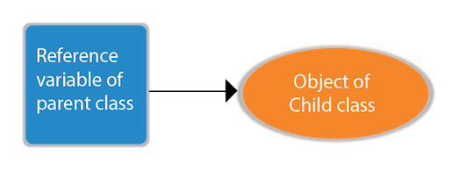

Slide 23
class A{}
class B extends A{}
A a=new B();//upcasting
For upcasting, we can use the reference variable of class type or an interface type. For Example:
interface I{}
class A{}
class B extends A implements I{}
Here, the relationship of B class would be:
B IS-A A
B IS-A I
B IS-A Object
Since Object is the root class of all classes in Java, so we can write B IS-A Object.

Slide 24
Example of Java Runtime Polymorphism
In this example, we are creating two classes Bike and Splendor. Splendor class extends Bike class and overrides its run() method. We are calling the run method by the reference variable of Parent class. Since it refers to the subclass object and subclass method overrides the Parent class method, the subclass method is invoked at runtime.
Since method invocation is determined by the JVM not compiler, it is known as runtime polymorphism.

Slide 25
class Bike{
void run(){System.out.println("running");}
}
class Splendor extends Bike{
void run(){System.out.println("running safely with 60km");}
public static void main(String args[]){
Bike b = new Splendor();//upcasting
b.run();
}
}

Slide 26
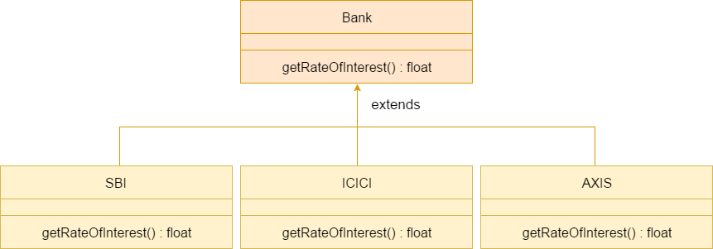
Java Runtime Polymorphism Example: Bank
Consider a scenario where Bank is a class that provides a method to get the rate of interest. However, the rate of interest may differ according to banks. For example, SBI, ICICI, and AXIS banks are providing 8.4%, 7.3%, and 9.7% rate of interest.

Slide 27
class Bank{
float getRateOfInterest(){return 0;}
}
class SBI extends Bank{
float getRateOfInterest(){return 8.4f;}
}
class ICICI extends Bank{
float getRateOfInterest(){return 7.3f;}
}
class AXIS extends Bank{
float getRateOfInterest(){return 9.7f;}
}
class TestPolymorphism{
public static void main(String args[]){
Bank b;
b=new SBI();
System.out.println("SBI Rate of Interest: "+b.getRateOfInterest());
b=new ICICI();
System.out.println("ICICI Rate of Interest: "+b.getRateOfInterest());
b=new AXIS();
System.out.println("AXIS Rate of Interest: "+b.getRateOfInterest());
}
}

Slide 28
Java Runtime Polymorphism with Data Member
A method is overridden, not the data members, so runtime polymorphism can't be achieved by data members.
In the example given below, both the classes have a data member speedlimit. We are accessing the data member by the reference variable of Parent class which refers to the subclass object. Since we are accessing the data member which is not overridden, hence it will access the data member of the Parent class always.
class Bike{
int speedlimit=90;
}
class Honda3 extends Bike{
int speedlimit=150;
public static void main(String args[]){
Bike obj=new Honda3();
System.out.println(obj.speedlimit);//90
}

Slide 29
Java Runtime Polymorphism with Multilevel Inheritance
Let's see the simple example of Runtime Polymorphism with multilevel inheritance.
class Animal{
void eat(){System.out.println("eating");}
}
class Dog extends Animal{
void eat(){System.out.println("eating fruits");}
}
class BabyDog extends Dog{
void eat(){System.out.println("drinking milk");}
public static void main(String args[]){
Animal a1,a2,a3;
a1=new Animal();
a2=new Dog();
a3=new BabyDog();
a1.eat();
a2.eat();
a3.eat();
}
}

Slide 30
Different ways to overload the method
By changing the no. of arguments
By changing the datatype
Why method overloading is not possible by changing the return type
Can we overload the main method
method overloading with Type Promotion

Slide 31
If a class has multiple methods having same name but different in parameters, it is known as Method Overloading.
If we have to perform only one operation, having same name of the methods increases the readability of the program.
Suppose you have to perform addition of the given numbers but there can be any number of arguments, if you write the method such as a(int , int) for two parameters, and b(int , int , int) for three parameters then it may be difficult for you as well as other programmers to understand the behavior of the method because its name differs
Advantage of method overloading
Method overloading increases the readability of the program.
Different ways to overload the method
There are two ways to overload the method in java
By changing number of arguments
By changing the data type

Slide 32
1) Method Overloading: changing no. of arguments
In this example, we have created two methods, first add() method performs addition of two numbers and second add method performs addition of three numbers.
In this example, we are creating static methods so that we don't need to create instance for calling methods.
class Adder{
static int add(int a,int b){return a+b;}
static int add(int a,int b,int c){return a+b+c;}
}
class TestOverloading1{
public static void main(String[] args){
System.out.println(Adder.add(11,11));
System.out.println(Adder.add(11,11,11));
}}

Slide 33
Method Overloading: changing data type of arguments
In this example, we have created two methods that differs in data type. The first add method receives two integer arguments and second add method receives two double arguments.
class Adder{
static int add(int a, int b){return a+b;}
static double add(double a, double b){return a+b;}
}
class TestOverloading2{
public static void main(String[] args){
System.out.println(Adder.add(11,11));
System.out.println(Adder.add(12.3,12.6));
}}

Slide 34
Abstraction
Way of managing complexity by suppressing the complex details
Abstraction refers to the act of representing essential features that are of interest of the users without including background details or explanation.
Users of a complex system are presented with a well defined simple interface for its use
Classes use the concept of abstraction for hiding unnecessary implementation/algorithmic details of its methods.
As user of any ‘class’ what you should be aware about that class ?

Slide 35
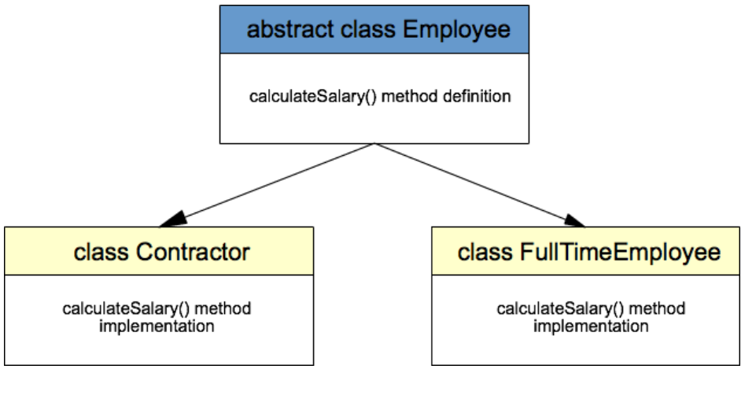
Abstraction is a process of hiding the implementation details from the user. Оnly the functionality will be provided to the user. In Java, abstraction is achieved using abstract classes and interfaces. We have a more detailed explanation on Java Interfaces,

Slide 36
public abstract class Employee {
private String name;
private int paymentPerHour;
public Employee(String name, int paymentPerHour) {
this.name = name;
this.paymentPerHour = paymentPerHour;
}
public abstract int calculateSalary();
public String getName() {
return name;
}
public void setName(String name) {
this.name = name;
}
public int getPaymentPerHour() {
return paymentPerHour;
}
public void setPaymentPerHour(int paymentPerHour) {
this.paymentPerHour = paymentPerHour;
}
}

Slide 37
public class Contractor extends Employee {
private int workingHours;
public Contractor(String name, int paymentPerHour, int workingHours) {
super(name, paymentPerHour);
this.workingHours = workingHours;
}
@Override
public int calculateSalary() {
return getPaymentPerHour() * workingHours;
}
}
class FullTimeEmployee extends Employee {
public FullTimeEmployee(String name, int paymentPerHour) {
super(name, paymentPerHour);
}
@Override
public int calculateSalary() {
return getPaymentPerHour() * 8;
}
}

Slide 38
Encapsulation
Encapsulation means wrapping/binding up of data-part (state) and methods (operations , code) together in the form of a capsule.
Access to code (Methods) and data (instance fields) is tightly controlled.
Through Encapsulation, developer of a class can decide what and what can not be accessible outside a class. [ public , private , protected ]
A class is a perfect example of an Encapsulation

Slide 39
